Slide 1
DYNAMIC PROGRAMMING dp
DESIGN AND ANALYSIS OF ALGORITHMS
LECTURER: Nguyễn Thanh Sơn
CS112.L23.KHCL.N12

Slide 2
The shortest path
4
A D
1
11
18
9
2
5
13
S
B
E
T
16
2
5
C F
2
Apply the Greedy approach, the shortest path from S to T is?

Slide 3
The shortest path
The Greedy approach can not be applied to this case:
(S, A, D, T) 1+4+18=23
The real shortest path is:
(S, C, F, T) 5+2+2=9
So today we will learn about a new algorithm

Slide 4
CONTENT
What is Dynamic Programming?
Characteristics of Dynamic Programming
Dynamic Programming Methods
Compare with other algorithms
Steps in Dynamic Programming
List of Dynamic Programming Problems

Slide 5
1. What is Dynamic programMing?
Dynamic programming (DP) approach is similar to Divide and Conquer in breaking down the problem in smaller and yet smaller possible sub-problems.
But unlike Divide and Conquer, results of these smaller sub-problems are remembered and used for similar or overlapping sub-problems.

Slide 6
2. Characteristics of Dynamic Programming
Overlapping Subproblems
Optimal Substructure

Slide 7
Overlapping Subproblems
There exist some places where we solve the same subproblem more than once

Slide 8

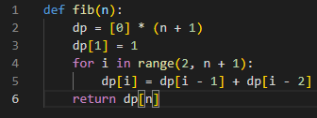
EX:
DP:

Slide 9
Optimal Substructure
The optimal solution to the problem contains within optimal solutions to its subproblems.

Slide 10
EX:
3
2
7
1
4
S
A
B
T
5
5
6
d_{min} (S, T) =
d_{min}(S, A) + d_{min}(A, B) + d_{min}(B, T)
= 1 + 2 + 5
= 8
Dijkstra

Slide 11
3. Dynamic Programming Methods
DP offers two methods to solve a problem:
Top-down with Memoization
Bottom-up with Tabulation

Slide 12
3. Dynamic Programming Methods
Top-down with Memoization
MemoRization
f5
In this approach, we try to solve the bigger problem by recursively finding the solution to smaller sub-problems. Whenever we solve a sub-problem, we cache its result so that we don’t end up solving it repeatedly if it’s called multiple times. Instead, we can just return the saved result. This technique of storing the results of already solved subproblems is called Memoization.
f3
f4
f1
f2
f2
f3
f0
f1
f0
f1
f2
f1
f0
f1

Slide 13
3. Dynamic Programming Methods
Top-down with Memoization
f5
F=[]
def Fib(n):
if n in F:
return F[n]
if (n < 2):
return 1
result = Fib(n-2) + Fib(n-1)
F[n] = result
return result
f3
O(n)
f4
f1
f2
f2
f3
f0
f1
f0
f1
f2
f1
f0
f1

Slide 14
3. Dynamic Programming Methods
Bottom-up with Tabulation
f5
Tabulation is the opposite of the top-down approach and avoids recursion. In this approach, we solve the problem “bottom-up” (i.e. by solving all the related sub-problems first). This is typically done by filling up an n-dimensional table. Based on the results in the table, the solution to the top/original problem is then computed.
f3
f4
f1
f2
f2
f3
f0
f1
f0
f1
f2
f1
f0
f1

Slide 15
3. Dynamic Programming Methods
Bottom-up with Tabulation
f5
def Fib(n):
F[0] = 0
F[1] = 1
for i in 2...n
F[i] = F[i-2] + F[i-1]
return F[n]
O(n)
f3
f4
f1
f2
f2
f3
f0
f1
f0
f1
f2
f1
f0
f1

Slide 16
Comparison
Top-down with Memoization | Bottom-up with Tabulation
Easy to set up | Gets complicated if there are multiple conditions
Must be solved from the top down | Must be solved from the bottom up
Slower due to recursion | Faster, due to direct access to the results stored in the table
Just solve the necessary problems | Must solve all subproblems

Slide 17
4. Compare with other algorithms
Dynamic programming vs Greedy method
Dynamic programming | Greedy method
DP are motivated for an overall optimization of the problem | Local optimization is addressed

Slide 18
Dynamic programming | Greedy method
1. Dynamic Programming is used to obtain the optimal solution. | 1. Greedy Method is also used to get the optimal solution.
2. In Dynamic Programming, we choose at each step, but the choice may depend on the solution to sub-problems. | 2. In a greedy Algorithm, we make whatever choice seems best at the moment and then solve the sub-problems arising after the choice is made.
3. Less efficient as compared to a greedy approach | 3. More efficient as compared to a greedy approach
4. Example: 0/1 Knapsack | 4. Example: Fractional Knapsack
5. It is guaranteed that Dynamic Programming will generate an optimal solution using Principle of Optimality. | 5. In Greedy Method, there is no such guarantee of getting Optimal Solution.

Slide 19
4. Compare with other algorithms
Dynamic programming vs Divide and Conquer
Dynamic Programming | Divide and Conquer
DP use the output of a smaller sub-problem and then try to optimize a bigger sub-problem and use Memoization to remember the output of already solved sub-problems. | Solutions are combined to achieve an overall solution

Slide 20
Dynamic programming | Divide and Conquer
1. It involves the sequence of four steps: Characterize the structure of optimal solutions. Recursively defines the values of optimal solutions. Compute the value of optimal solutions in a Bottom-up minimum. Construct an Optimal Solution from computed information. | 1. It deals (involves) three steps at each level of recursion: Divide the problem into a number of subproblems. Conquer the subproblems by solving them recursively. Combine the solution to the subproblems into the solution for original subproblems.
2. It is non Recursive. | 2. It is Recursive.
3. It solves subproblems only once and then stores in the table. | 3. It does more work on subproblems and hence has more time consumption.
4. It is a Bottom-up approach. | 4. It is a top-down approach.
5. In this subproblems are interdependent. | 5. In this subproblems are independent of each other.
6. For example: Matrix Multiplication. | 6. For example: Merge Sort & Binary Search etc.

Slide 21
Dynamic Programming
Paradigm
Methodology
Overlapping Subproblems
Memoization
Top-down approach
Divide and Conquer
AND
OR
Optimal Substructure
Tabulation
Bottom-up approach

Slide 22
5. Steps in Dynamic Programming
Characterize structure of an optimal solution.
Define value of optimal solution recursively.
Compute optimal solution values either top-down with caching or bottom-up in a table.
Construct an optimal solution from computed values.

Slide 23
6. List of Dynamic Programming Problems
Kadane’sao Algorithm
0 1 Knapsack Problem
Longest Increasing Subsequence Problem
Edit Distance Problem
Integer Knapsack Problem
Fibonacci Numbers Problem
Rod Cutting Problem
Subset Sum Problem
Coin change Problem
Treats for the Cows
You can find more Dynamic Programming problems here.

Slide 24
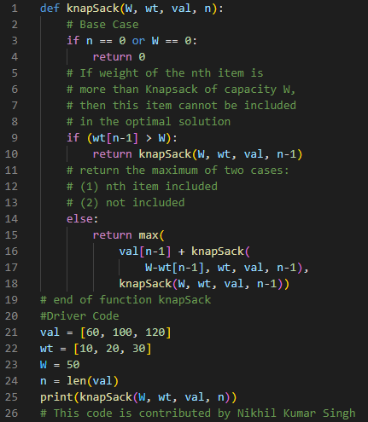
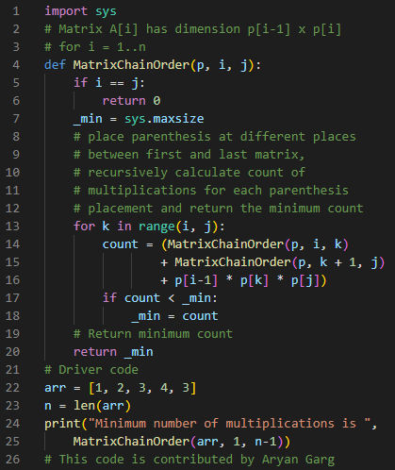
0-1 Knapsack Problem Matrix Chain Multiplication

Slide 25
KAHOOT!

Slide 26
HOMEWORK
Gmail: 19521482@gm.uit.edu.vn
Deadline: 11h59 PM, 30/05/2021

Slide 27
The shortest path
4
A D
1
11
18
9
2
5
13
S
B
E
T
16
2
5
C F
2
Apply the Dynamic programming, the shortest path from S to T is?

Slide 28
thanks!
Any questions?
You can review these slides on our team's GitHub

Slide 29
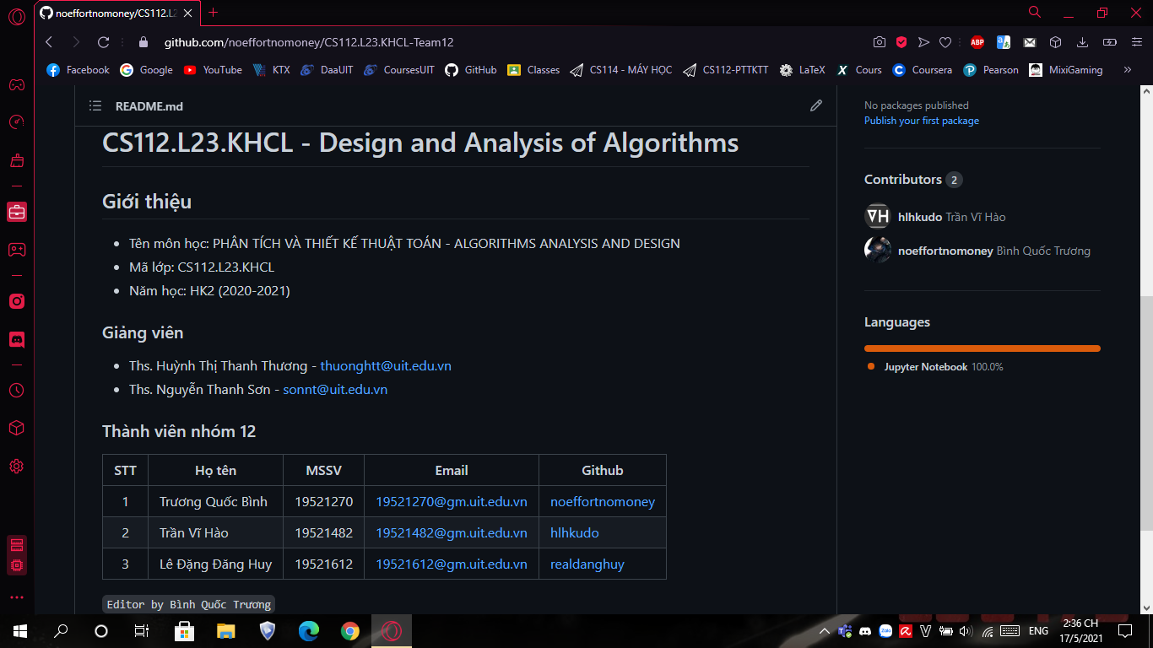
Place your screenshot here
Our team’s github link:
https://github.com/noeffortnomoney/CS112.L23.KHCL-Team12

Slide 30
Credits
Special thanks to all the people who made and released these awesome resources for free:
Presentation template by SlidesCarnival
TOPDev.vn
educative.io
tutorialspoint.com
geeksforgeeks.org
gacsach.vn
Some PowerPoint files in the Reference section (GitHub)

